Slide 1



WAVECON TELECOM ANALYSIS
WEEK 2 -TASK 4
RAVINA KARNIK

Slide 2

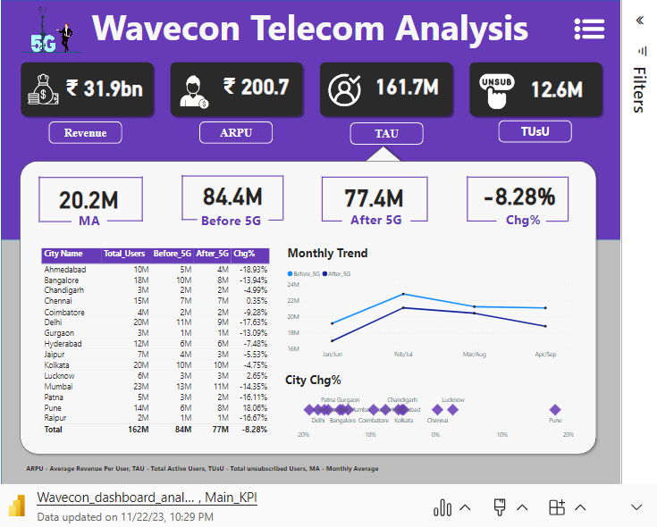
Microsoft Power BI

Slide 3

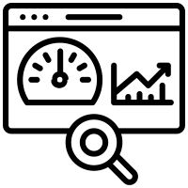



OBJECTIVES
Revenue
KPI
Plan
Plan Affected
discontinued
impact of the 5G launch on our revenue
underperforming KPI’s after the 5G launch
Plan analysis after 5G launch
Plan affected largely by the 5G launch
discontinued Plan

Slide 4
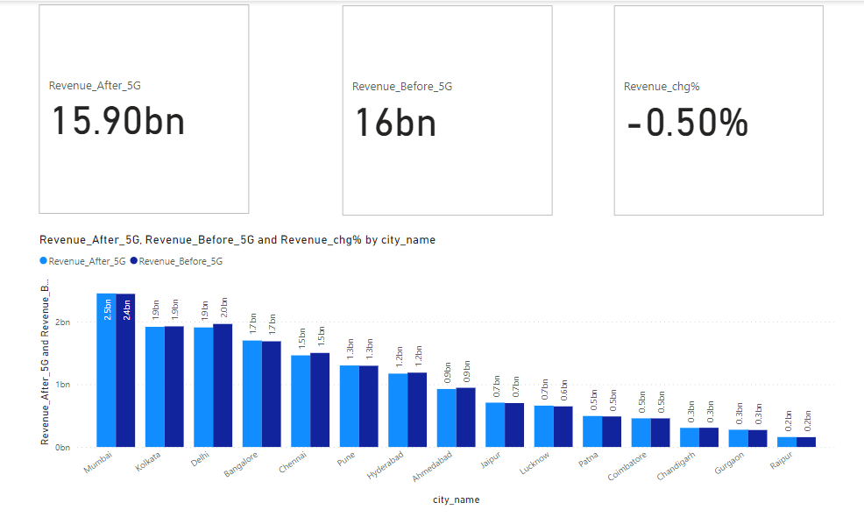
What is the impact of the 5G launch on our revenue?
Revenue after 5G
Revenue before 5G
Revenue change %
15.90 bn
16.00 bn
-0.50 %

Slide 5
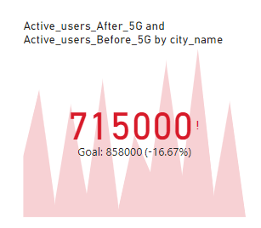

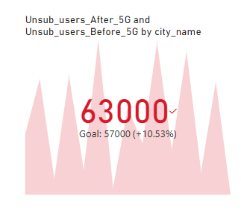

Which KPI is underperforming after the 5G launch?
Active users after 5G
Unsub_users after 5G
77 M
6 M
Active users before 5G
Unsub_users after 5G
84 M
7 M
Active users change %
Unsub_users chg % 5G
-8.28 %
23.50%

Slide 6
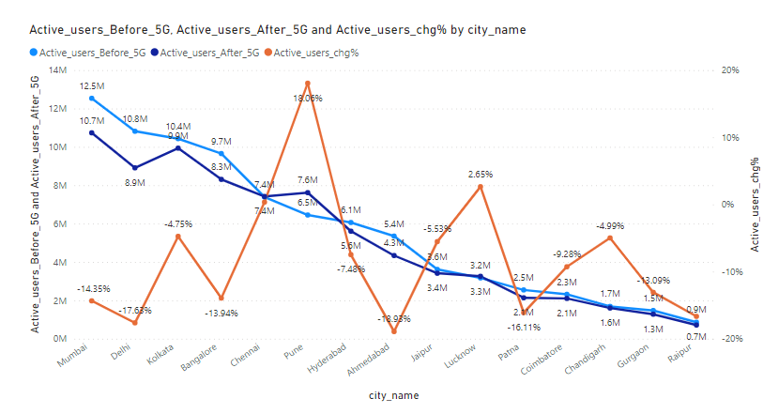
Pune city has positive high percentage change +18% which means active users are increases after 5G launch.
Only Three cities Chennai, Pune, Lucknow have positive change. others have negative change %

Slide 7
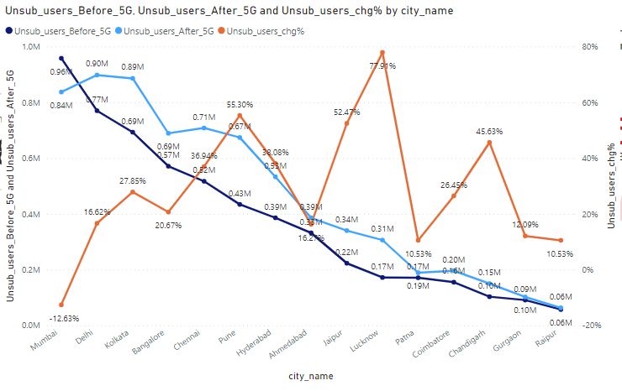
Only /Mumbai city has negative percentage change -12.63% which means unsubscribed users are decreases after 5G launch.
Remaining all cities have unsubscribe users are increases after 5G launch.

Slide 8
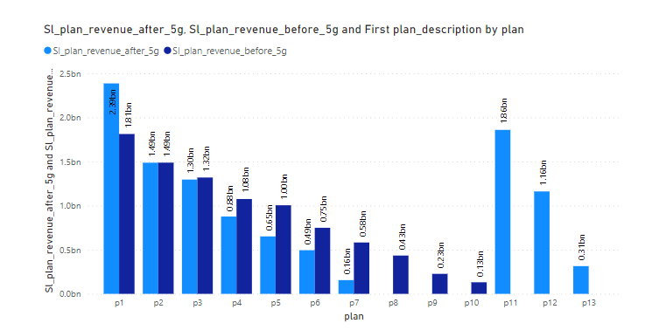
After the 5G launch, which plans are performing well and Which are not performing well in terms of revenue?
only plan p1 is performing well because its value is increases after 5G launch.
Plan p11,p12 and p13 are launched after 5G launches and in that p11 and p12 are performing well as compared to p13.

Slide 9
Is there any plan affected largely by the 5G launch? Should we continue or discontinue that plan?
Plan p8(Daily Saviour (1 GB / Day) validity: 1 Day),p9(Combo TopUp: 14.95 Talktime and 300 MB data),p10(Big Combo Pack (6 GB / Day) validity: 3 Days) are largely affected by the 5G launch.they have zero increment in their revenue hence we discontinue with that plan.

Slide 10
Is there any plan that is discontinued after the 5G launch? What is the reason for it?

Slide 11
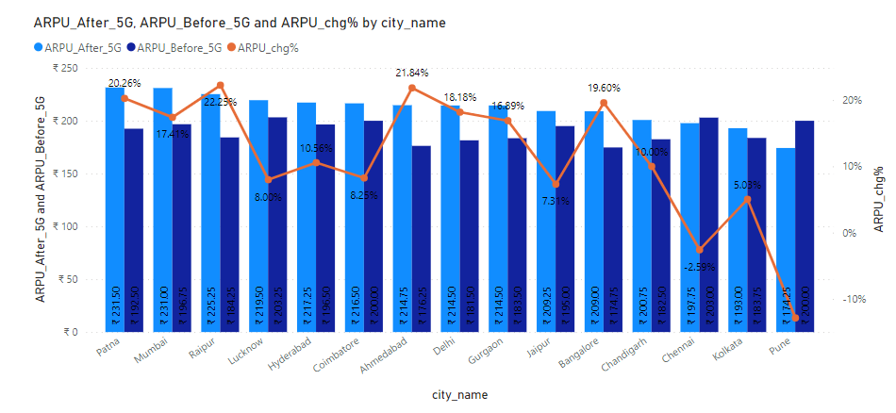
Impact of 5G launch on ARPU in different cities

Slide 12
DATA CENTER BUSINESS PLAN
$155.00
Mercury is the smallest planet of them all
Mercury
Mercury is the closest planet to the Sun and the smallest one in the entire Solar System. This planet's name has nothing to do with the liquid metal
Despite being closer to the Sun than Venus, its temperatures aren't as terribly hot as that planet's
Its surface is quite similar to that of Earth's Moon, which means there are a lot of craters and plains
Speaking of craters, many of them were named after artists or authors who made significant contributions to their respective fields

Slide 13
DATA CENTER BUSINESS PLAN
December
08
Mars is a very cold place. It’s full of iron oxide dust
MO | TU | WE | TH | FR | SA | SU
 |  |  | 1 | 2 | 3 | 4
5 | 6 | 7 | 8 | 9 | 10 | 11
12 | 13 | 14 | 15 | 16 | 17 | 18
19 | 20 | 21 | 22 | 23 | 24 | 25
26 | 27 | 28 | 29 | 30
12
Jupiter is the biggest planet in the Solar System
21
Mercury is the smallest planet in the Solar System
27
Venus is extremely hot, even more than Mercury
Meetings
Launches

Slide 14
DATA CENTER BUSINESS PLAN
 | JAN | FEB | MAR | APR | MAI | JUN | JUL | AUG | SEP | OCT | NOV | DEC
Mercury
Venus
Mars
Jupiter
Mercury is very small
Venus is a hot planet
Mars is a cold planet
Jupiter is very big
Saturn
Neptune
Earth
Venus

Slide 15
DATA CENTER BUSINESS PLAN
Jupiter
25%
Jupiter is very big
Mars
50%
Mars is a cold place
Mercury
75%
It’s a small planet

Slide 16
DATA CENTER BUSINESS PLAN
Mars
Venus
Despite being red, Mars is actually a cold place. It’s full of iron oxide dust
Venus has a beautiful name and is the second planet from the Sun
50%
75%

Slide 17
DATA CENTER BUSINESS PLAN
Neptune
It’s the farthest planet from the Sun
Venus
Saturn
Jupiter
Mars
Mercury
Jupiter is the biggest planet of them all
Despite being red, Mars is a very cold place
Mercury is the closest planet to the Sun

Slide 18
DATA CENTER BUSINESS PLAN
Venus is the second planet from the Sun
Venus has extremely high temperatures
Venus has a poisonous atmosphere
Venus
Saturn has several rings
Saturn is composed of hydrogen and helium
Saturn has more than eighty moons
Saturn
Jupiter is the biggest planet of them all
Jupiter was named after a Roman god
Jupiter is a gas giant
Jupiter

Slide 19
DATA CENTER BUSINESS PLAN
Mercury
It’s the closest planet to the Sun
Venus
Neptune
Jupiter
Jupiter is the biggest planet of them all
It’s the farthest planet from the Sun
Saturn
Mars
Mars is actually a really cold place

Slide 20
DATA CENTER BUSINESS PLAN
50%
Mercury
It’s the closest planet to the Sun
Saturn
Jupiter
Jupiter is the biggest planet of them all
Jupiter is a gas giant and the biggest planet in the Solar System. It’s the fourth-brightest object in the night sky. It was named after a Roman god
Mars
Mars is actually a really cold place

Slide 21
DATA CENTER BUSINESS PLAN
Study | Date | Target | Age | Country
Saturn | 04/03/20XX | Mars | 35-45 | Mars
Venus | 05/04/20XX | Venus | 45-50 | Mercury
Mars | 06/05/20XX | Neptune | 50-60 | Venus
Jupiter | 07/06/20XX | Jupiter | 60-90 | Neptune

Slide 22
DATA CENTER BUSINESS PLAN
Saturn
01
Mercury
Neptune
Jupiter is a gas giant and the biggest planet in the Solar System. It’s the fourth-brightest object in the night sky. It was named after a Roman god
02
Jupiter
Venus
Earth
03
Mars
Uranus

Slide 23
DATA CENTER BUSINESS PLAN
Task | Description | Goals
Venus | Venus has a beautiful name and is the second planet from the Sun. It’s terribly hot, even hotter than Mercury, and its atmosphere is extremely poisonous | Venus is hot Saturn has rings Mars is red
Mercury | Mercury is the closest planet to the Sun and the smallest one in the entire Solar System. It was named after the Roman messenger god | Jupiter is huge Neptune is far away Earth harbors life

Slide 24
DATA CENTER BUSINESS PLAN
Step 1 | Step 2 | Step 3
Mercury | Venus | Saturn
Mercury is the closest planet to the Sun and the smallest in the Solar System | Venus has a beautiful name and is the second planet from the Sun | Despite being red, Mars is actually a cold place. It’s full of iron oxide dust
500 | 1,500 | 5,500

Slide 25
IMPACT OF 5G LAUNCH
Bottom
5
Top
5

Slide 26
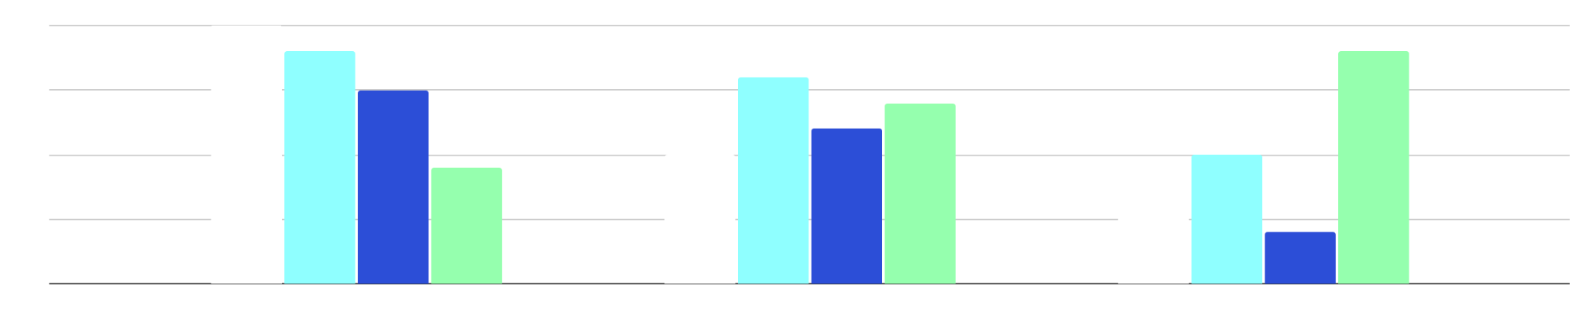
DATA CENTER BUSINESS PLAN
Mars
Saturn
Jupiter
Mars is actually a really cold place
Saturn is composed of hydrogen and helium
Jupiter is the biggest planet of them all
Group 1
Group 2
Group 3
Group 4
Follow the link in the graph to modify its data and then paste the new one here. For more info, click here

Slide 27
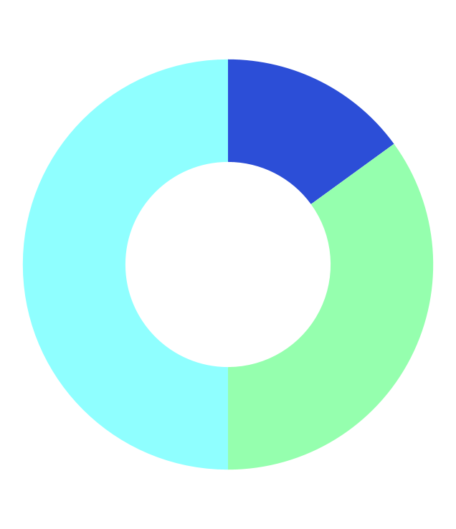
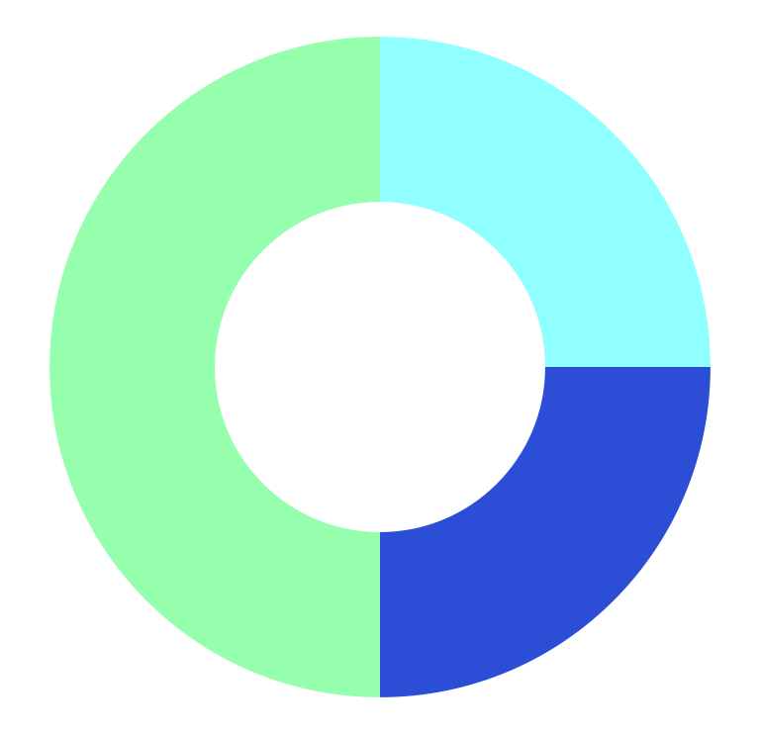
DATA CENTER BUSINESS PLAN
Mars
Jupiter
15%
35%
50%
25%
25%
50%
Venus
Neptune
Saturn
Venus
Saturn
Jupiter
Follow the link in the graph to modify its data and then paste the new one here. For more info, click here

Slide 28
DATA CENTER BUSINESS PLAN
Saturn
20XX
20XX
Mars
It’s composed of hydrogen and helium
Mars is actually a very cold place
Neptune
20XX
20XX
Jupiter
Neptune is very far from the Sun
Jupiter is the biggest planet of them all
Mercury
20XX
20XX
Venus
It’s the closest planet to the Sun
Venus has extremely high temperatures

Slide 29
DATA CENTER BUSINESS PLAN
Jupiter
Mercury
Jupiter is the biggest planet of them all
It’s the closest planet to the Sun
20XX
20XX
20XX
20XX
Mars
Neptune
Mars is actually a very cold place
It’s the farthest planet from the Sun

Slide 30
DATA CENTER BUSINESS PLAN
Step 4
Step 3
Step 2
Neptune
Step 1
Mercury
Mars
It’s the farthest planet from the Sun
Jupiter
It’s the closest planet to the Sun
Mars is actually a very cold place
Jupiter is the biggest planet of them all

Slide 31
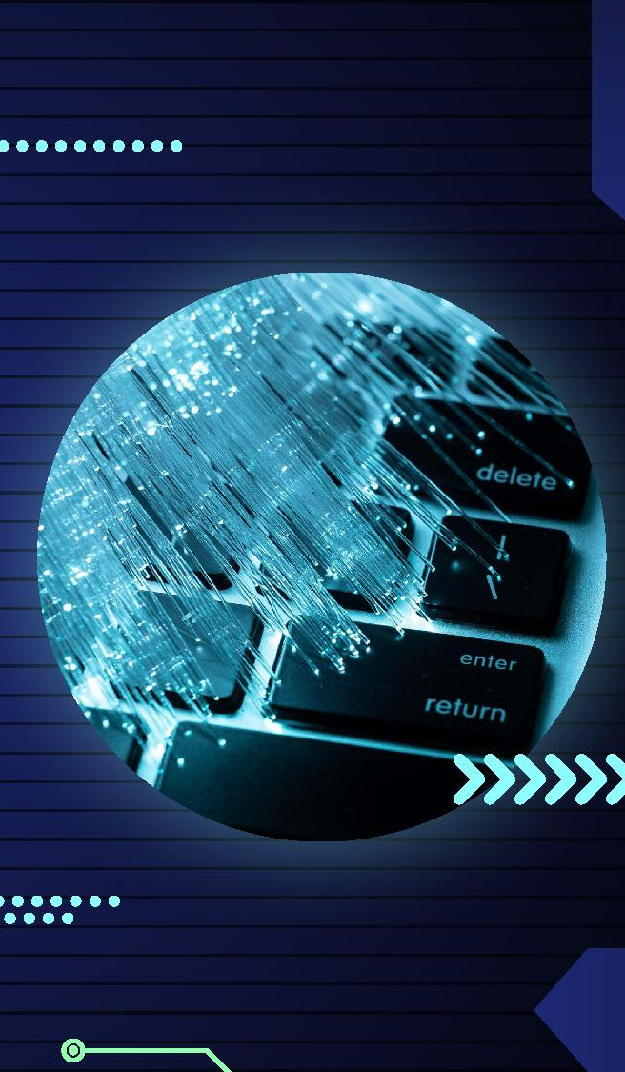
DATA CENTER BUSINESS PLAN
Neptune
Mercury
It’s the farthest planet from the Sun
It’s the closest planet to the Sun
Jupiter
Mars
Jupiter is the biggest planet of them all
Mars is actually a very cold place

Slide 32
DATA CENTER BUSINESS PLAN
Mars
Jupiter
Venus
Mars is actually a very cold place
Jupiter is the biggest planet of them all
Venus has a beautiful name and is the second planet from the Sun
75%
Neptune
Mercury
It’s the farthest planet from the Sun
It’s the closest planet to the Sun

Slide 33
DATA CENTER BUSINESS PLAN
Neptune
Mercury
It’s the farthest planet from the Sun
It’s the closest planet to the Sun
Jupiter
Mars
Jupiter is the biggest planet of them all
Mars is actually a very cold place

Slide 34
DATA CENTER BUSINESS PLAN
5,000,000
Mercury is the smallest planet in the Solar System
15,000,000
Jupiter
Neptune
Saturn is composed mostly of hydrogen and helium
Jupiter is the biggest planet of them all
It’s the farthest planet from the Sun

Slide 35
DATA CENTER BUSINESS PLAN
10%
40%
40%
Women
Men
Other
Despite being red, Mars is actually a cold place. It’s full of iron oxide dust
Venus has a beautiful name and is the second planet from the Sun
It’s the closest planet to the Sun and the smallest one in the Solar System

Slide 36
DATA CENTER BUSINESS PLAN
Time | Task
9:00 | Mercury is a small planet
11:00 | Mars is a cold place
13:00 | Jupiter has a beautiful name
17:00 | Saturn has several rings
18:00 | Neptune is very far from us
20:00 | Venus has a beautiful name
Venus
Venus has a beautiful name and is the second planet from the Sun
Jupiter is an enormous planet
Mercury is very small
Venus is very hot
Mercury
Neptune
It’s the closest planet to the Sun
It’s the farthest planet from the Sun

Slide 37
DATA CENTER BUSINESS PLAN
Jupiter
Mars
Mercury
Neptune
Jupiter is the biggest planet of them all:
List 1
List 2
List 3
Mars is actually a very cold place:
List 1
List 2
List 3
It’s the closest planet to the Sun:
List 1
List 2
List 3
It’s the farthest planet from the Sun:
List 1
List 2
List 3

Slide 38
DATA CENTER BUSINESS PLAN
Yes
No
Mercury is quite a small planet
Neptune is very far from the Sun
Jupiter
Earth has life
Neptune is far
Saturn is big
Jupiter is the biggest planet of them all
Jupiter is huge
Mars is red
Venus is hot

Slide 39




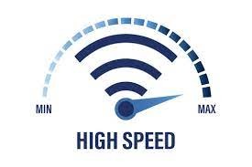
Revenue Elevation Strategies
Exclusive Promotions
Customized Offerings:
Offer special promotions and discounts to existing customers for contract renewals.
Adapt services based on the unique needs of different regions.
Workshops and Webinars
Broaden Service Offerings:
Workshops and Webinars: Conduct educational sessions to showcase the benefits of premium services
Broaden Service Offerings: Introduce new services such as high-speed internet, smart home solutions, or enterprise package

Slide 40

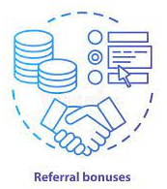


Active Users Increase Strategies
Employee Training:
Incentivized Referrals:
Train employees to provide excellent customer service and support
Launch a referral program offering discounts or additional data for customers who refer new users.
Language Options:
Interactive Apps:
Language Options: Provide multilingual support to cater to a wider audience.
Develop interactive mobile apps with features like bill tracking, data usage monitoring, and customer support.

Slide 41
DATA CENTER BUSINESS PLAN
100M
Jupiter
Jupiter is a gas giant and the biggest planet in the Solar System
50M
Venus
25M
Venus has a beautiful name and is the second planet from the Sun
Earth
Earth is the third planet from the Sun and the only one that harbors life in the Solar System

Slide 42
Instructions for use
If you have a free account, in order to use this template, you must credit Slidesgo in your final presentation. Please refer to the next slide to read the instructions for premium users.
As a Free user, you are allowed to:
- Modify this template.
- Use it for both personal and commercial projects.
You are not allowed to:
- Sublicense, sell or rent any of Slidesgo Content (or a modified version of Slidesgo Content).
- Distribute Slidesgo Content unless it has been expressly authorized by Slidesgo.
- Include Slidesgo Content in an online or offline database or file.
- Offer Slidesgo templates (or modified versions of Slidesgo templates) for download.
- Acquire the copyright of Slidesgo Content.
For more information about editing slides, please read our FAQs or visit our blog:
https://slidesgo.com/faqs and https://slidesgo.com/slidesgo-school

Slide 43
Instructions for use (premium users)
As a Premium user, you can use this template without attributing Slidesgo.
You are allowed to:
Modify this template.
Use it for both personal and commercial purposes.
Share this template in an editable format with people who are not part of your team.
You are not allowed to:
Sublicense, sell or rent this Slidesgo Template (or a modified version of this Slidesgo Template).
Distribute this Slidesgo Template (or a modified version of this Slidesgo Template) or include it in a database or in any other product or service that offers downloadable images, icons or presentations that may be subject to distribution or resale.
Use any of the elements that are part of this Slidesgo Template in an isolated and separated way from this Template.
Register any of the elements that are part of this template as a trademark or logo, or register it as a work in an intellectual property registry or similar.
For more information about editing slides, please read our FAQs or visit our blog:
https://slidesgo.com/faqs and https://slidesgo.com/slidesgo-school

Slide 44
Infographics
You can add and edit some infographics to your presentation to present your data in a visual way.
Choose your favourite infographic and insert it in your presentation using Ctrl C + Ctrl V or Cmd C + Cmd V in Mac.
Select one of the parts and ungroup it by right-clicking and choosing “Ungroup”.
Change the color by clicking on the paint bucket.
Then resize the element by clicking and dragging one of the square-shaped points of its bounding box (the cursor should look like a double-headed arrow). Remember to hold Shift while dragging to keep the proportions.
Group the elements again by selecting them, right-clicking and choosing “Group”.
Repeat the steps above with the other parts and when you’re done editing, copy the end result and paste it into your presentation.
Remember to choose the “Keep source formatting” option so that it keeps the design. For more info, please visit our blog.

